Slide 1

Recycling
Alberto, Emanuele, Mattia, Mark.

Slide 2
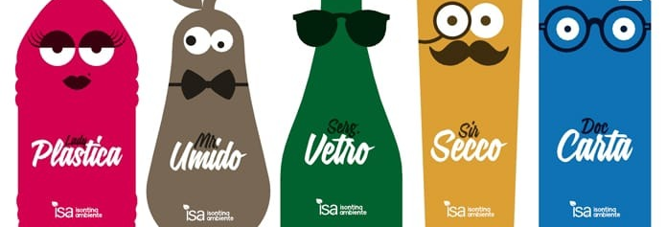
What is recycling and why we should recycle?
When we recycle we reuse a material that was utilized already by someone else.
That’s really important because when we do that we help our planet and we reduce the pollution.

Slide 3
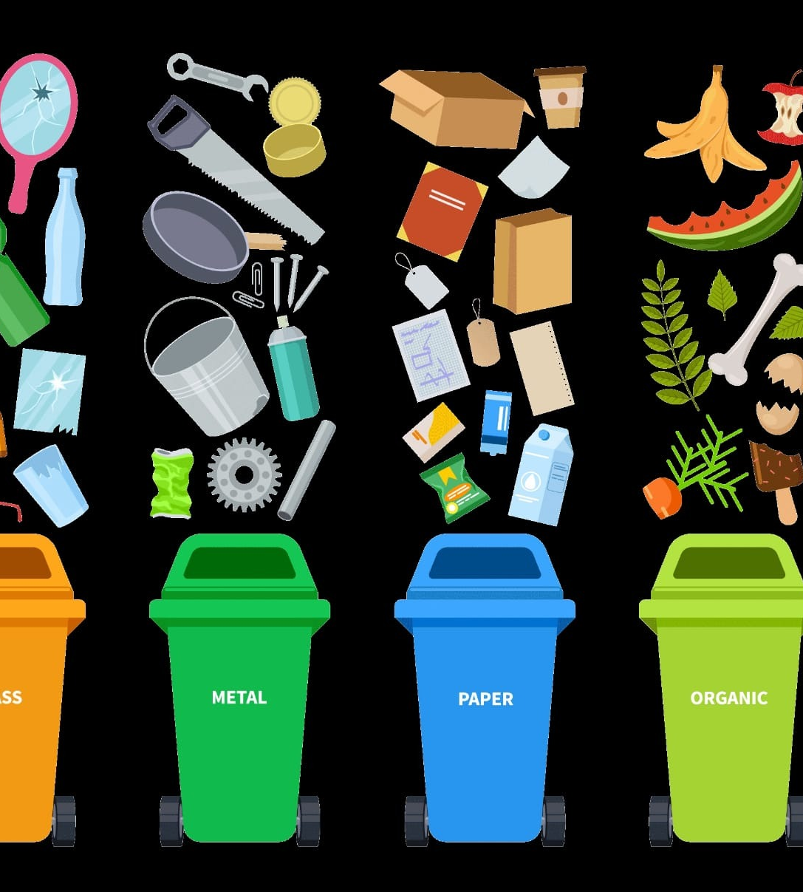
What is the importance of recycling??
Recycling Helps us, animals, the air and also the Soil. By doing this we reduce the greenhouse effect As we can breath a better air. Materials like glass, metal, wood, plastic, cloth, paper and cardboard can be recycled at 100%. All materials can be recycled?
The answer is no, not all materials can be recycled.
A lot of Materials like toys, pens, diapers, ceramic and basins cannot be recycled because they already have a shape and it is difficult to change it to what we want.

Slide 4
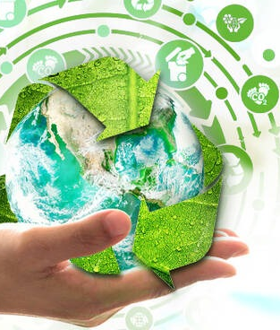
What is the country that recycling most materials?
Italy is the European country with the highest percentage of recycling of the total waste of 79% with an incidence more than twice the EU average and well above all the other large countries (France is at 56%, the United Kingdom at 50%, Germany at 43%).

Slide 5
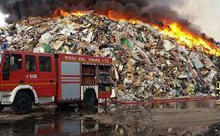
The problems of italy.
Roberto Mancini found the land of fires. It's a big part of territory in the between of Naples and Caserta, sadly it is famous for the presence of toxic trash.
This is very dangerous for people who live in this place for their sanity but also for the air which is seriously damaged.
A lot of people dies of cancer because of this very big and important problem.

Slide 6

How to improve recycling?
Today, a lot of people are recycling and this is helping countries in difficult times.
Looking at the future positively, perhaps plastic may not be a problem anymore because people learned how to manage it, instead, if we think negatively, plastic and other materials may destroy our planet, reaching a point where there is no going back.

